Slide 1
How to run python in VSCode
Please write in python to output with below data:
- I love my crush.
- Hack Facebook my girlfriend.
- ---***--- Do you love python?
- +++---> Hey, girl do you love me?
- What is the road to your heart?

Slide 2

How to install npm
@By H.Kimhab

Slide 3
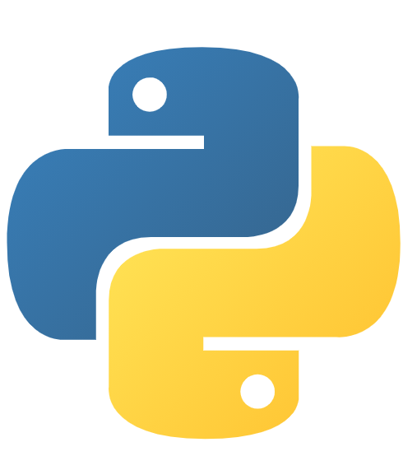
Remove List Items
@By H.Kimhab

Slide 4

Bootstrap Nav
- Base Nav
Bootstrap 4.5
@By H.Kimhab

Slide 5
- Base Nav
Bootstrap 4.5
@By H.Kimhab

Slide 6
+ Available Styles
- Horizontal alignment
Bootstrap Nav
- Vertical
Bootstrap 4.5
@By H.Kimhab

Slide 7
Tuples
@By H.Kimhab

Slide 8
Tuple
Ordered & Unchanged
Syntax(“value1”, “value2”)
Index[0] is first and second[1]
Allow Duplicate
Len & Type
One item, remember add comma (e.g tu = (“value1”,)
Any and Different Data Types
Double round-brackets (e.g tu = tuple((“value1”, “value2”))
@By H.Kimhab

Slide 9

How to create account Linkedin
@By H.Kimhab

Slide 10
Access Tuples
@By H.Kimhab

Slide 11
Access Tuple
By inside square brackets (e.g tuple[0])
Negative Index (e.g tuple[-1])
Range of Index (tuple[1:3]) (note: not include index 3)
+ tuple[:3] from start but not end
+ tuple[2:] from 2 to end
+ tuple[-4:-1] (let’s test (tuple[-1:-4])
Check exist item with in in keyword
@By H.Kimhab

Slide 12
Update Tuples
@By H.Kimhab

Slide 13
How to run Python in VSCode
@By H.Kimhab

Slide 14
Access Tuple
Convert to list, Update it and Convert it back to tuple(01)
Remove (First Follow 01 and Remove )
Add (First Follow 01 and Add)
@By H.Kimhab

